Slide 1
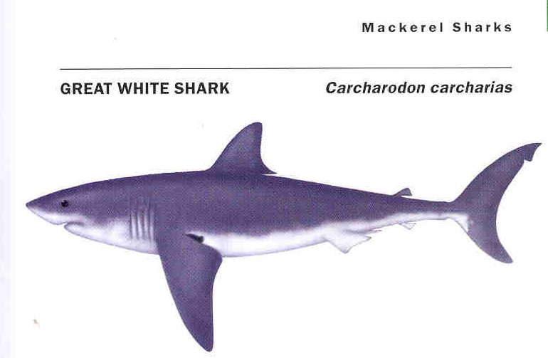
Using demographic analysis to assess the population size of shark species: a test using the White Shark (Carcharodon carcharias) sub-population off central California, USA Gregor M. Cailliet¹, Kenneth J. Goldman^{2 ,}, Henry F. Mollet^{1,3} ¹Moss Landing Marine Laboratories, Moss Landing CA 95039-9647, USA ² Alaska Department of Fish and Game, 3298 Douglas Place, Homer, AK 99603 USA ³ Monterey Bay Aquarium, 886 Cannery Row, Monterey, CA 93940-1023 USA
Based upon:
Squillante in Ebert (2003)
Acknowledgements: Karyn Brewster-Geisz, Steve Campana, Jason Cope, Enric Cortes, Dave Ebert, Malcolm Francis, Selina Heppell, Lynn McMassters, Chris Perle, Colin Simpfendorfer,

Slide 2
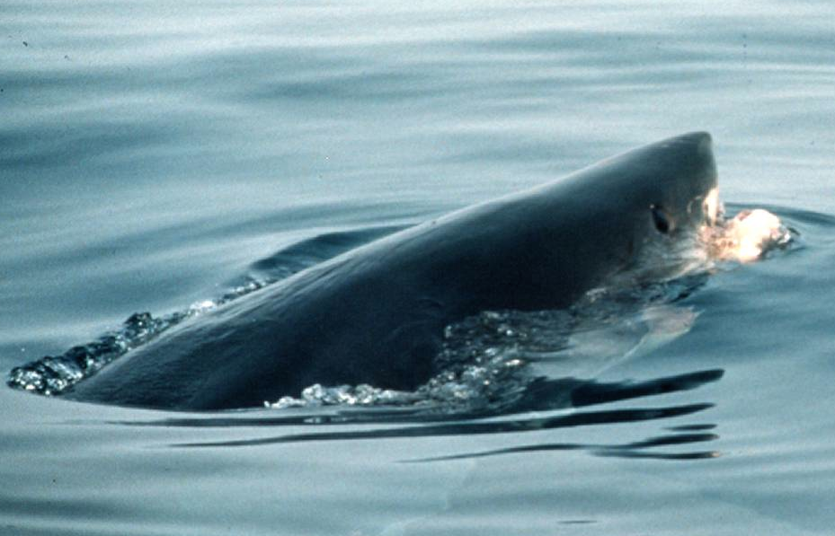
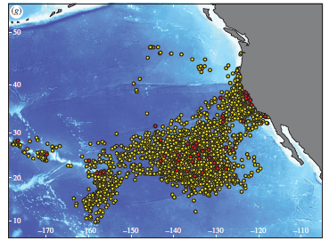
White Sharks (Carcharodon carcharias) are:
Difficult to sample because they are large & highly migratory (see below);
Move both vertically and horizontally; and
Tend to segregate by sex, age and size.
Thus, their population or sub-population sizes are difficult to estimate.
Ken Goldman Photo
But some studies have tried to do this in several places around the world.
This is our attempt.
Jorgensen et al. (2010) and TOPP Tracking Data (http://www.coml.org/projects/tagging-pacific-predators-topp)

Slide 3
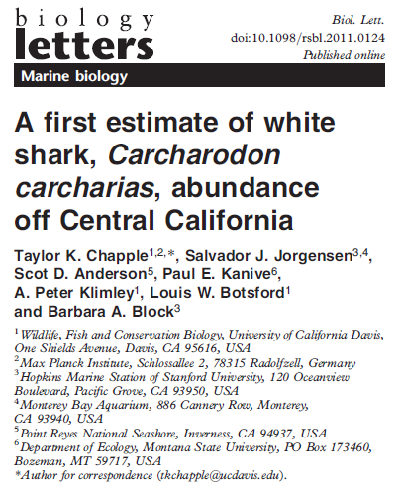
A recent tag-recapture study (Chapple et al. 2011) used photographic identification of the trailing edge of the first dorsal fin as natural individual marks and used this to estimate the number of sub-adult and adult White Sharks presently in the central California sub-population.
These authors used the results from a Bayesian hypergeometric model to conclude that the:
Central California population consists of only 219 mature and sub-adult white sharks (highest-posterior density estimate);
With a 95% credible interval of 130 and 275;
Where sub-adults are defined as being sexually immature;
and
Older juveniles are found with adults in aggregation areas.

Slide 4
Chapple et al. (2011) further concluded that:
This represented ~50% of the mature and sub-adult White Sharks for the entire eastern North Pacific Ocean (ENP); and
When all life stages were considered, the total population of white sharks was “far lower” than that of other apex predators.
This very low estimate created serious concern about the status of the California White Shark population, and consequently resulted in petitions to consider white sharks as a candidate for the U.S. (Federal Register / Vol. 77, No. 189 / Friday, September 28, 2012 / Proposed Rules) and State of California endangered species (ESA) lists.
Under the Federal Endangered Species Act, an endangered species is defined as “any species which is in danger of extinction throughout all or a significant portion of its range.”

Slide 5
We wanted to re-assess this population estimate and demonstrate the utility of demographic analyses and age distribution as useful methods for estimating population sizes in sharks.
Demography has been applied to several species of sharks, including White Sharks (Mollet & Cailliet 2002).
For this purpose, one needs a reasonable idea of age structure, often gained from size structure, and some age-specific population parameters.

Slide 6
DEMOGRAPHIC ANALYSIS
Was based upon an evaluation of existing and new life history information on the White Shark, Carcharodon carcharias:
SIZE & AGE FREQUENCIES
GROWTH RATES
AGE-SPECIFIC REPRODUCTION
MORTALITY ESTIMATES
and
STAGE-BASED MATRIX MODELS,
AGE-BASED LESLIE MATRICES,
and
LIFE HISTORY TABLES
(Mollet & Cailliet 2002)

Slide 7
DEMOGRAPHIC POPULATION MODEL ESTIMATES
FOR ALL AGE CLASSES
We used demographic parameters to assess the size of the White Shark (Carcharadon carcharias) population off central California because recent studies provided appropriate data but did not utilize a demographic approach.
We aimed to estimate a new minimum total population estimate for White Sharks off California coast using demographics, life history matrix information, and a conservative extension of Chapple et al.’s (2011) estimate to include age classes that were either poorly sampled, or not sampled at all, by their methodology.
We did not attempt estimate the total population of White Sharks throughout the ENP as there are insufficient length, age and abundance data on which to base demographic models for the entire region.

Slide 8
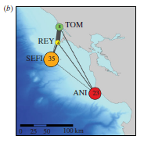
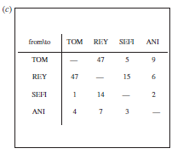
To re-assess Chapple et al.’s (2011) sub-population estimate to produce a population estimate for all life stages of White Sharks, we relied on well-established demographic methods based on previously published estimates of vital life history parameters (Mollet & Cailliet, 2002).
Jorgensen et al. (2010) sampled 179 White Sharks from the three locations below (Tomales Point, SE Farallon Islands, and Año Nuevo Island). However Chapple et al. (2011) only used data from the first two locations. Therefore, for our analysis, we only used data from those locations, not Año Nuevo Island, most closely reflecting how their estimate of 219 mature and sub-adult sharks was derived.
Ken Goldman Photo

Slide 9
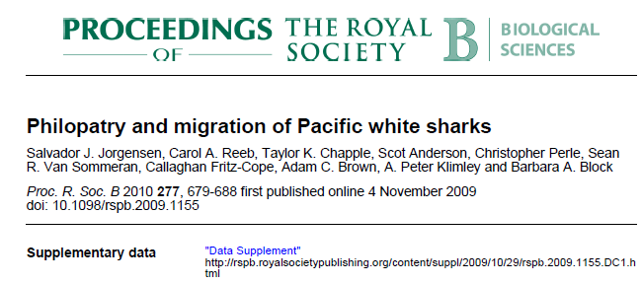
AGE- & SIZE-BASED FREQUENCIES
The size-frequency and sex of the sharks sampled by Chapple et al. (2011)
can be inferred from Jorgensen et al. (2010) as both studies were run in parallel.
We generated sex-specific size frequencies for the 130 White Sharks enumerated by Jorgensen et al. (2010), assuming that these are the same sharks sampled by the parallel study of Chapple et al. (2011), for which no data on individual sharks were provided. See the next slides for the data…

Slide 10
SUPPLEMENTARY MATERIAL
Table S1. Electronic tags deployed and DNA sampled from white sharks (Carcharodon carcharias) in the North Eastern Pacific, 2000-2008
­­­­­­­­­­­­­­­­­­___________________________________________________________________________________________
Shark# Tag date Location* TL Sex PAT# ACU# Haplotype Offshore Site† Pop-up Track days
­­­­­­­­­­­­­­­­­­­­­­­­­­___________________________________________________________________________________________
1 10/16/00 FAR 457 M 1 H 13-Apr-01 179
2 10/16/00 FAR 518 - 2
3 10/16/00 FAR 488 - 3
4 10/16/00 FAR 518 F 4
5 11/09/00 FAR 381 - 5
6 11/09/00 FAR 518 F 6
7 11/05/01 FAR 457 - 7 H/C 3-May-02 179
8 11/05/01 FAR 488 F 8 C 19-Jul-02 256
9 11/05/01 FAR 427 M 9 C 14-Jul-02 251
10 11/05/01 FAR 442 F 10 9-Dec-01 34
11 11/15/01 FAR 450 M 11 C 11-Jun-02 208
12 11/15/01 FAR 380 M 12 13-Jan-02 59
13 11/12/02 FAR 430 M 13
14 11/15/02 FAR 530 F 14 C 14-Feb-03 91
15 09/24/03 FAR 427 - 15 C 22-Mar-04 180
16 10/08/03 FAR 442 M 16
17 10/23/03 FAR - F 17
18 10/27/03 FAR 396 M 18
19 10/31/03 FAR 488 - 19 C 5-Jun-04 218
20 10/31/03 FAR 488 M 20
21 10/13/04 TOM 381 - 21 Scot
22 11/05/04 FAR - M 22 C 6-Sep-05 305
23 11/05/04 FAR 457 M 23 C 4-Apr-05 150
24 11/05/04 FAR 457 M 24 C 7-Mar-05 122
25 11/05/04 FAR 427 M 25 C 10-May-05 186
26 11/15/04 FAR - - GU002302
27 11/30/04 FAR 396 F 26 H 10-Jun-05 192
28 11/30/04 FAR 490 F 27 C 3-May-05 154
29 12/03/04 FAR 426 F 28 8-Feb-05 67
30 10/01/05 ANO 397 - GU002303
31 10/01/05 ANO 488 - GU002303
32 10/20/05 ANO 411 - 29 C 30-Apr-06 192
33 10/20/05 ANO 411 M 30
34 11/02/05 ANO 411 F 31 C 29-Aug-06 300
35 11/05/05 ANO 488 F 32 C 2-Aug-06 270
36 11/06/05 FAR 488 - 33 GU002304 C 29-May-06 204
37 11/09/05 ANO 411 - 34 C 7-Aug-06 271
38 11/10/05 ANO - - GU002303
39 11/10/05 FAR 457 M 35 C 4-Aug-06 267
40 11/16/05 ANO 411 F 36 H/C 16-Oct-06 334
41 11/16/05 ANO 427 - 37 7-Jan-06 52
42 11/17/05 FAR 488 F 38 GU002305 C 15-Aug-06 271
Scot Anderson
Notes:
The point here is to show:
They actually encountered (and tagged or biopsied) A LOT of sharks from 2000- 2008, they claimed 179 individuals in Jorgensen et al.
This however, includes Ano, which we do not…with Ano removed, there are 130
Note the slide transition makes it look like one scrolling page
May also note how frequently the length 427 and 457 come up…that is 14 and 15 feet, respectively. This is why we used 30 cm bins with 425 and 455 as bin centers…

Slide 11
43 11/17/05 FAR 366 M 39
44 11/18/05 FAR 396 M 42 GU002307
45 11/18/05 ANO 366 M 40 GU002306 C 17-Jul-06 241
46 11/18/05 ANO 457 F 41 GU002303 C 17-Sep-06 303
47 11/18/05 ANO 400 - 43 C 21-Jul-06 245
48 11/18/05 ANO 488 - 44 C 16-Sep-06 302
49 11/19/05 FAR 488 M 45 GU002308 C 26-Aug-06 280
50 11/19/05 FAR 488 F 46 C 16-Sep-06 301
51 11/20/05 ANO 427 - GU002309
52 11/20/05 ANO 442 - GU002307
53 11/20/05 FAR 427 M 47 C 17-Aug-06 270
54 11/20/05 FAR 457 M 48 C 19-May-06 180
55 11/21/05 FAR 427 M 49 GU002310 C 19-Aug-06 271
56 11/22/05 FAR 457 M 50 C 18-Jul-06 238
57 12/09/05 TOM 426 - 51
58 12/15/05 TOM 472 F 52
59 12/15/05 ANO 480 F 53 H 11-Oct-06 300
60 12/15/05 ANO 390 M 54 C 3-Aug-06 231
61 01/21/06 ANO 400 F 55 H/C 9-Nov-06 292
62 01/21/06 ANO 400 F 56 H 3-Sep-06 225
63 10/02/06 FAR 335 M 57 GU002307 19-Jan-07 109
64 10/03/06 FAR 488 M 59 GU002307 C 12-Jun-07 252
65 10/03/06 FAR 518 M 58 GU002303 C 27-Apr-07 206
66 10/05/06 FAR - M GU002311
67 10/09/06 FAR 366 M 63 GU002314
68 10/09/06 FAR 366 M 62 GU002313 H 2-Mar-07 144
69 10/09/06 FAR 366 M 60 GU002312
70 10/09/06 FAR 488 F 61 GU002303 C 5-Jun-07 362
71 10/10/06 FAR 488 M 65 GU002316 H 7-Jan-07 89
72 10/10/06 FAR 510 M 64 GU002315 C 6-Aug-07 300
73 10/10/06 FAR 427 M 67 GU002307 18-Dec-06 69
74 10/10/06 FAR 518 M 66 GU002303 C 6-Aug-07 300
75 10/10/06 FAR 457 M 68 GU002303
76 10/10/06 FAR 427 - 69 H 20-Sep-07 239
77 10/10/06 FAR 427 M 70 9-Jan-07 91
78 10/11/06 REY 427 M 71
79 10/14/06 FAR 518 M 1
80 10/20/06 FAR 472 M 72 2 GU002303
81 10/23/06 FAR 488 M 3
82 10/23/06 FAR 488 M 4
83 10/23/06 FAR 427 M 5
84 10/23/06 FAR 396 M 6 GU002307
85 10/31/06 FAR - - GU002307
86 11/01/06 FAR 457 - 7 GU002307 H
87 11/01/06 FAR 457 - 8 GU002303
88 11/01/06 FAR 533 - 73 9 GU002307 H/C 29-Jul-07 270
89 11/01/06 FAR 488 - 10
90 11/01/06 FAR 442 F 74 C 21-Jan-07 81
91 11/01/06 FAR 488 F 75 C 25-Jul-07 266

Slide 12
92 11/01/06 FAR 427 F 76 13-Nov-06 12
93 11/05/06 TOM 457 F 77 18-Nov-06 13
94 11/10/06 ANO 488 F 11
95 11/10/06 TOM 441 M 78 12 GU002317 C 13-May-07 164
96 11/10/06 ANO 366 M 79 C 26-Mar-07 136
97 11/10/06 ANO 426 F 80 9-Jan-07 60
98 11/18/06 ANO 488 F 81
99 11/20/06 TOM 503 F 13 GU002307
100 12/03/06 ANO 396 F 14
101 12/03/06 ANO 473 F 15 H
102 12/03/06 TOM 396 - 82 GU002307 H/C 18-Jul-07 227
103 12/05/06 TOM 488 F 16 GU002307
104 01/24/07 ANO - F 17 GU002318
105 01/24/07 ANO 427 M 18
106 01/24/07 TOM 411 - 19 H
107 01/24/07 TOM 305 - 20 GU002307
108 01/24/07 ANO 457 F 83
109 09/17/07 FER* - M GU002321
110 10/06/07 ANO 427 M 21 GU002303
111 10/06/07 ANO 427 M 84 22 GU002307
112 10/07/07 ANO 427 M 85 GU002319
113 10/07/07 FAR - - GU002303
114 10/07/07 TOM 400 - 86
115 10/08/07 TOM 427 F 87 23
116 10/08/07 FAR - - GU002303
117 10/11/07 FAR 427 M 24 GU002303
118 10/11/07 FAR 457 M 88 GU002303
119 10/13/07 TOM 300 - 25
120 10/13/07 FAR 396 M 90 GU002307
121 10/13/07 FAR 457 M 89 GU002304 27-Nov-07 45
122 10/13/07 FAR 457 M 91 C 20-Dec-07 68
123 10/13/07 FAR 457 M 92 C 27-Jun-08 258
124 10/14/07 ANO 457 F 26
125 10/14/07 FAR 457 M 93 27 11-Dec-07 58
126 10/14/07 ANO 427 - 28
127 10/19/07 FAR 488 M 29 GU002307
128 10/19/07 FAR 457 M 30 GU002303
129 10/19/07 FAR 427 M 94 H 18-Feb-08 122
130 10/22/07 FAR 477 M 31 GU002303
131 10/22/07 FAR 477 M 32 GU002316
132 10/22/07 FAR 411 M 33
133 10/23/07 FAR 477 M 34 H
134 10/23/07 FAR 488 M 35
135 10/23/07 FAR - M 36 GU002303 H
136 10/24/07 FAR 518 F 95 37 2-Dec-07 39
137 10/27/07 FAR 518 F 96 38 GU002320 C 12-Sep-08 321
138 10/27/07 FAR 518 F 39 GU002303
139 10/28/07 TRI* 457 - 40 GU002307
140 10/28/07 FAR 518 - 41

Slide 13
141 11/01/07 FAR - - GU002303
142 11/04/07 TOM 304 F 42
143 11/05/07 TOM 366 F 43
144 11/05/07 TOM 427 - 44
145 11/12/07 TOM 366 F 45 GU002307
146 11/16/07 TOM 427 F 46
147 11/24/07 TOM 351 M 47
11/25/07 ANO 472 F 48
149 11/25/07 ANO 442 - 97 C 2-Apr-08 129
150 12/14/07 ANO 457 - 49
151 12/14/07 ANO 457 - 50 GU002303
152 01/17/08 TOM 335 - 51
153 09/14/08 TOM 366 F 52
154 09/14/08 TOM 442 M 53
155 09/17/08 TOM 457 M 54
156 09/24/08 TOM 366 M 55
157 09/26/08 TOM 427 M 56
158 09/27/08 TOM 442 M 57
159 09/28/08 TOM 320 F 58
160 10/01/08 TOM 259 - 59
161 10/01/08 TOM 396 F 60
162 10/06/08 TOM 396 M 61
163 10/06/08 TOM 488 M 62
164 10/12/08 FAR - M 63
165 10/13/08 FAR 442 M 64
166 10/13/08 FAR 396 M 65
167 10/13/08 FAR 457 M 66
168 10/17/08 TOM 488 F 67
169 10/22/08 REY 396 M 68
170 10/22/08 REY 457 M 69
171 10/27/08 FAR 396 M 70
172 10/29/08 FAR 427 M 71
173 10/29/08 FAR 488 M 72
174 10/30/08 TOM 427 M 73
175 11/05/08 TOM 488 F 74
176 11/06/08 REY 274 M 75
177 11/07/08 TOM 427 M 76
178 11/08/08 TOM 366 F 77
179 11/12/08 TOM 396 M 78
*Location codes; SEFI = Southeast Farallon Island, TOM = Tomales Point, ANI = Año Nuevo Island, REY = Point Reyes, TRI = Trinidad Head, HUM = Humbolt Bay. †Offshore sites visited; C = Café, H = Hawaii.

Slide 14
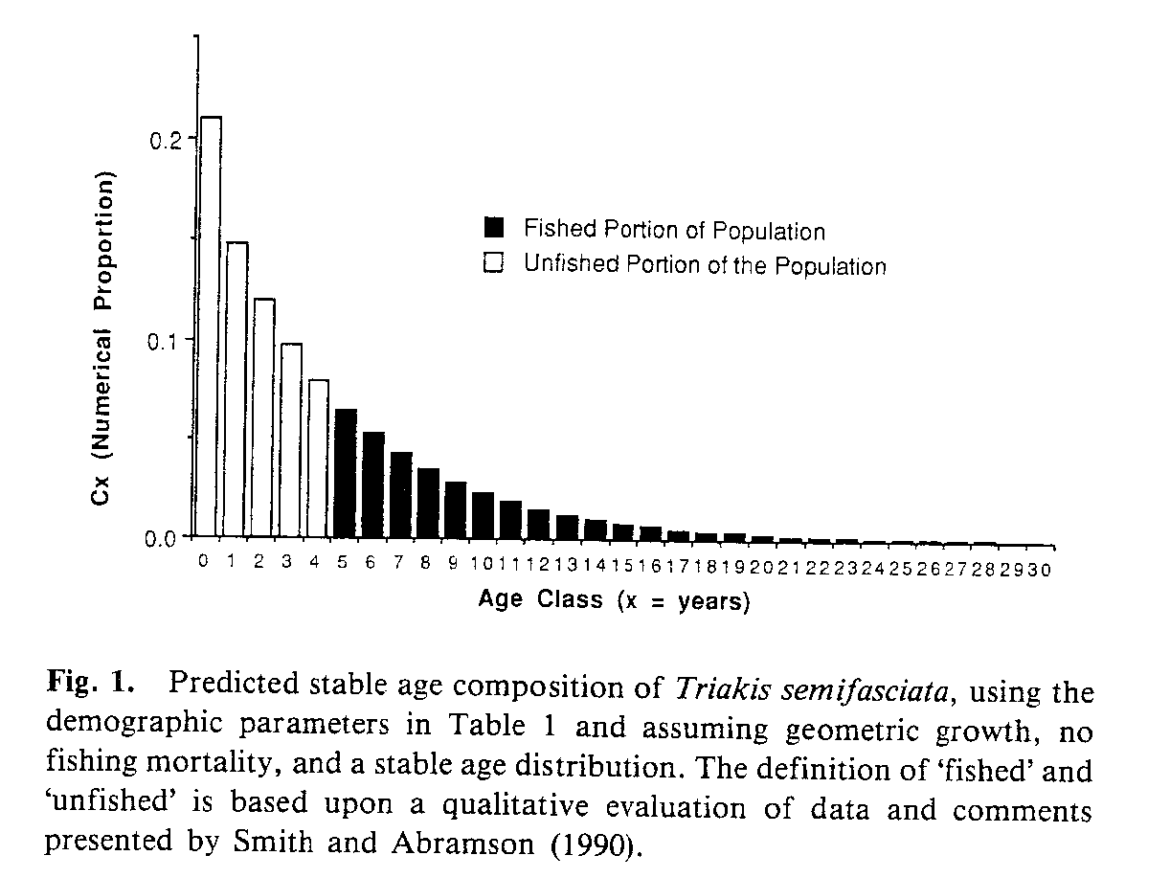
The estimated lengths of the 130 sharks enumerated by Jorgensen et al. (2010)
were binned at 30 cm (~1 ft) intervals. Lengths were converted to age using an established, although unvalidated, length-age relationship (Cailliet et al. 1985).
We then used natural mortality and life history estimates based on an assumed longevity of 30 years and increased fertility to insure a stationary age distribution (Lambda = 1.0) , based on life history information in Mollet & Cailliet (2002).
This is similar to what Cailliet (1992) did for his demographic study of Leopard Sharks (Triakis semifasciata) off central California.
Leopard Shark, Monterey Bay Aquarium

Slide 15
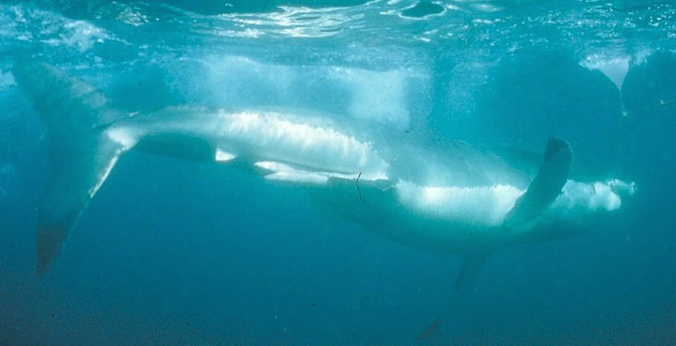
This allowed us to produce a survivorship curve and expected stationary age frequency distribution of White Sharks of all ages (life stages) for this sub-population.
Ken Goldman
Theoretical White Shark Survivorship Curve & Stationary Age Composition
Based upon Cailliet et al.’s (1985) VBGF and
Mollet & Cailliet’s (2002) demographic analysis
Note; Longevity estimates range from 30 to 60+ years
Age Estimate (years)

Slide 16
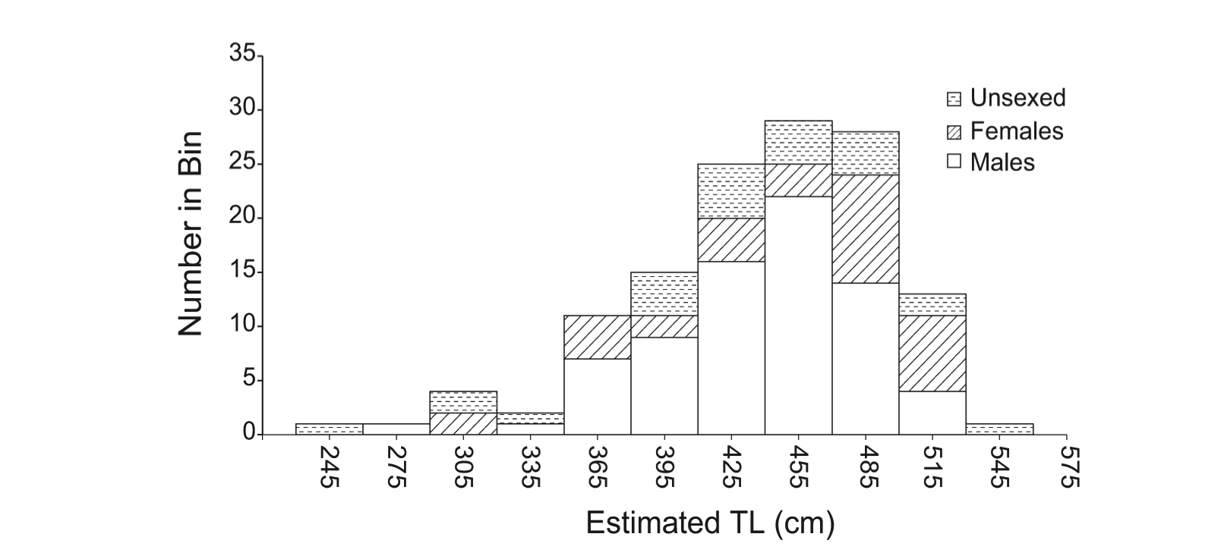
SIZE FREQUENCY DATA
From Jorgensen et al. (2010)
These size- and sex-frequency data, when compared to estimated sizes at maturity (males ~3.6 m, females at 4.5-5.0 m) reveal that they primarily sampled mature males plus a few sub-adults and small mature females.
Their sex ratio was 78 males: 33 females (χ2 = 10.6176, p < 0.01).
Large mature females were almost entirely absent from their sub-population estimate, and smaller size classes (pups, juveniles an sub-adults) were markedly under-represented.
We then converted these sizes to ages so they could be plotted on a stationary age distribution curve like in the previous slide.

Slide 17
DEMOGRAPHY
We used established demographic methodology (Mollet & Cailliet 2002) to generate a survivorship curve (stationary age distribution) using:
An assumed longevity of 30 years, a very conservative estimate given
existing growth functions;
An instantaneous natural mortality estimate of M= 0.1535
(~85.7% survivorship) per year;
Age at maturity = 15 years; and
Annual fertility (number of female pups per year) = 1.553, a slightly
higher rate than reported in the literature (e.g. Mollet & Cailliet 2002,
Francis 1996).
All to achieve a stationary age distribution (lambda = 1.0).

Slide 18
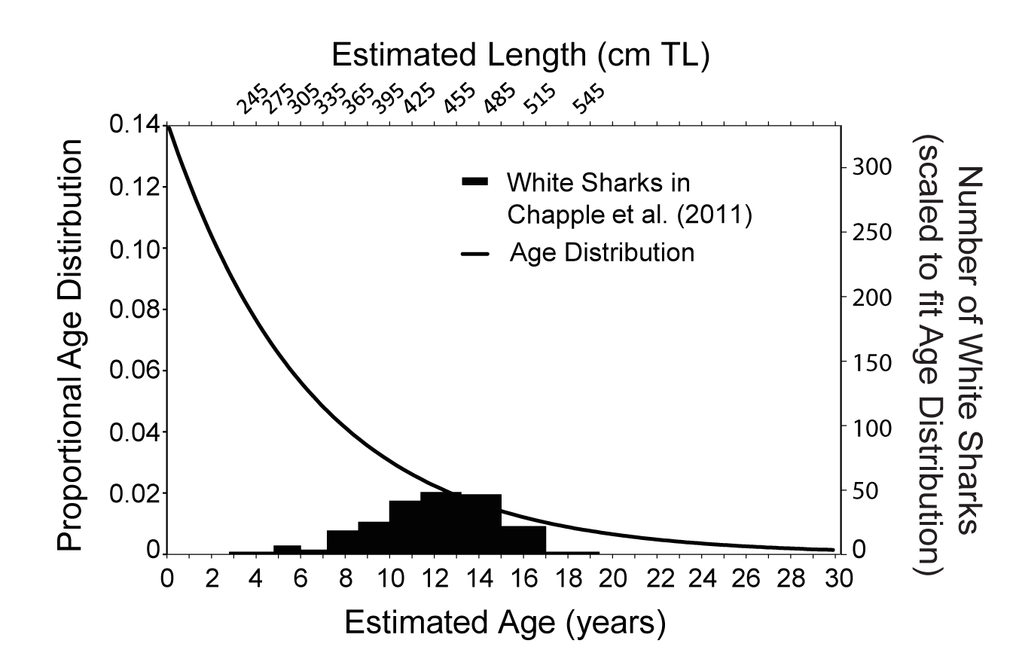
THE ABUNDANCE OF ALL LIFE STAGES
We matched the stationary age distribution to the realized proportional age frequency of Jorgensen et al. (2010), scaled to reflect Chapple et al.’s (2011) estimate of 219;
Then we matched the largest peaks in the sampled age frequency to the theoretical curve and applied the appropriate scaling factor to all other age classes, assuming that Chapple et al’s. (2011) estimate was correct for the most abundant age classes (12, 13, & 14); and
Then, we applied the proportion of estimated white sharks at a given age to those of ALL OTHER AGE CLASSES, we were able to derive a numerical estimate for all age classes combined.

Slide 19
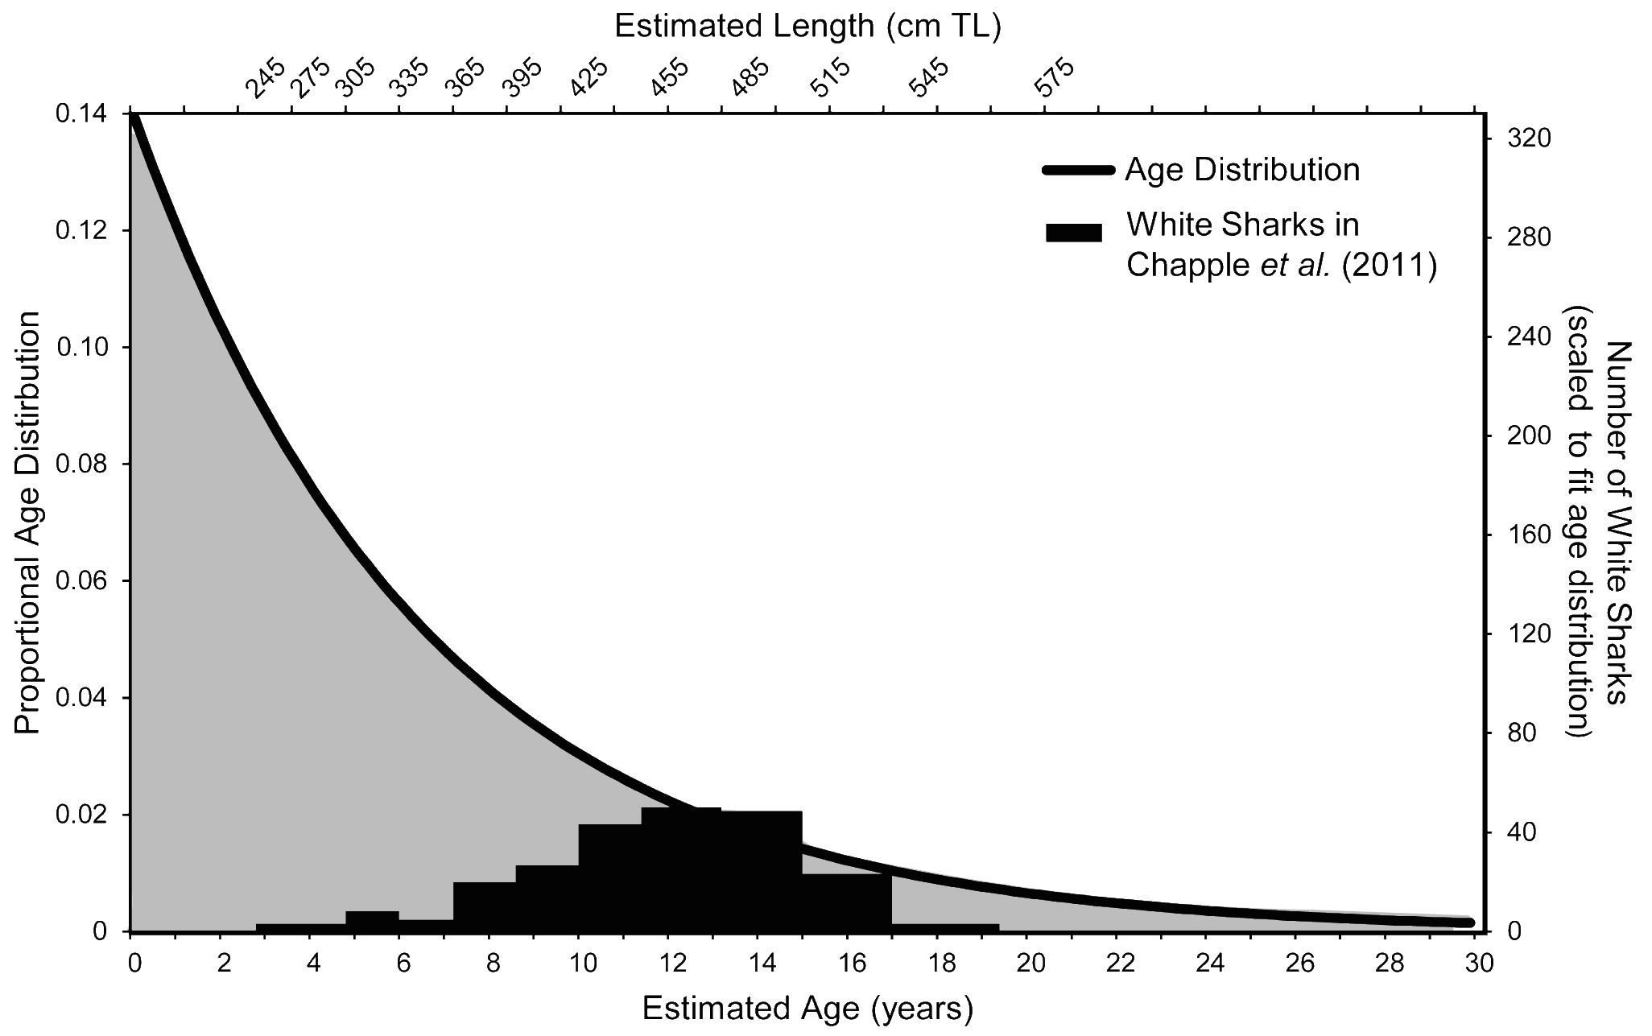
THE ABUNDANCE OF ALL LIFE STAGES
(Continued)
The “ALL OTHER AGE CLASSES” mentioned in the previous slide are represented in the grey shading below.
(These are mainly pups, YOY, juveniles and large adults)

Slide 20
OUR RESULTS
Chapple et al. (2011) only sampled a small proportion of the age distribution for the sub-population represented at the sampling locations.
Matching the sampled age frequency of the most abundant age classes with neighboring age distribution proportions (at 12, 13 and 14 yrs) and scaling appropriately provides an estimate of number of all life stages (ages) throughout coastal California would be at least 2,418 White Sharks.
The range was from 2,148 to 2,819 White Sharks, depending upon which size or age class we chose, with 2,418 as the final value with the best fit at age 13.
Increasing M by a factor of two to reflect increased mortality of early life stages for each of the two youngest age classes results in a negligible effect (<2%) on the population estimate.

Slide 21
What if White Sharks Live Longer than 30 years?
A recent study by Hamady et al. (2014) used bomb radiocarbon to validate the ages of 8 White Sharks from the western North Atlantic.
Their results suggested that White Sharks could perhaps live up to 60, maybe 70 yrs (also theoretically predicted by Cailliet et al. (1985).
This could then theoretically change the growth curves of White Sharks as follows:
Squillante in Ebert (2003)

Slide 22
What if White Sharks Live Longer than 30 years (continued)?
This would change the theoretical survivorship curve or stationary age distribution as seen below.
Age Estimate (years)
However, it would only make our population estimate even larger
(between ~3,450 to ~ 5,120 White Sharks; Burgess et al. 2014).
Notes:
This probably needs work and henry’s input

Slide 23
Our new estimate is comparable to white shark population size estimates from other locations around the world (Burgess et al. 2014)
*
*
*
* = Discussed in later slides

Slide 24
In the eastern North Pacific
(U.S. west coast):
Our estimate is similar to that from a recent independent status review by the NMFS (Dewar et al. 2014) of the ENP white shark population, which estimated ~3,000 individuals.
This status review team had access to virtually all available data from white shark researchers throughout the eastern North Pacific and used multiple modeling approaches.
Similar conclusions were made in a 2014 analysis by the California Department of Fish and Wildlife (and approved by the Commission)
Scot Anderson

Slide 25
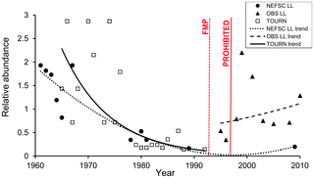
In the western North Atlantic:
Another study (Curtis et al. 2014) was just published indicating an increase in relative abundance of White Sharks:
Seasonal distribution and historic trends in abundance of White Sharks, Carcharodon carcharias, in the western North Atlantic Ocean, by Curtis TH, McCandless CT, Carlson JK, Skomal GB, Kohler NE, et al. (2014) Seasonal Distribution and Historic Trends in Abundance of White Sharks, Carcharodon carcharias, in the Western North Atlantic Ocean. PLoS ONE 9(6): e99240. doi: 10.1371/journal.pone.0099240

Slide 26
In Australia:
Malcolm et al. (2001) used catch and effort data, historical fishing records, shark control program records, cage-diving operation information, telemetry, tag and recapture, and shark attack data in a deterministic population size model to estimate a population size of between 2,728 and 13,746 female White Sharks.
In another study, Blower et al.( 2012), used genetic techniques to estimate the effective population size of white sharks off southern Australia at approximately 1,512 individuals.
This study also suggested that a minimum of 500-1,000 breeding individuals would be required to retain enough genetic variability and ensure evolutionary potential.
Although the size of the central California coastline is significantly smaller than the area studies in Australia, the differences in population size estimates is notable.
This also contrasts with statements by Chapple et al. (2011) that the size of the eastern North Pacific White Shark population is alarmingly low, and cited genetic diversity as a factor.

Slide 27
And, in South Africa:
A mark-recapture study by Towner et al. (2013) using photo-ID techniques at two adjacent White Shark aggregation locations in Gaansbi (Gans Bay), South Africa resulted in an abundance estimate of 908 (808-1008).
This study employed open-population models and used a common quantitative technique (qAIC) to compare between competing model parameterizations.
This sub-population abundance is more than three times the Chapple et al. (2011) mark-recapture estimate, in a region quite biogeographically similar to Farallon Islands and Tomales Bay.

Slide 28
CONCLUSIONS
Accurately estimating total population sizes of sharks requires methodologies that account for biases introduced by sampling a limited number of sites and include all life history stages across the species’ range.
Our results indicate that an all-life-stage sub-population size of at least 2,400 individual White Sharks in coastal California is required to account for the abundance of the 219 adults and sub-adults estimated in the original study. This is likely to be a conservative (under) estimate for the California sub-population.
The true total White Shark population size throughout the eastern North Pacific is likely several times greater than any estimates as all studies exclude non-aggregating,
or otherwise unobservable, sharks, and those that independently aggregate at other important eastern North Pacific sites.
Other studies using a variety of methods indicate the same thing as our demographic approach.
Our analysis indicates that White Shark abundance off central California is not in danger as previously proposed. Indications are that the ENP White Shark population is healthy and may be growing.

